Slide 1
PREVENTING THE THREATS OF TOMORROW WITH DEEP LEARNING
March 2019

Slide 2
Outline
What is Deep Learning ?
How Deep Learning is applied to cybersecurity?
Deep Learning @ Deep Instinct

Slide 3
WHAT IS DEEP LEARNING ?
Notes:
What is deep learning ?
Timeline
Before: shallow learning
Features
Linear/Non Linear Separation
Issues
Deep Learning
Multiple layers
Raw information to feature hierarchy to score
Accuracy Improvements
Why so recent?
Data, internet, computing power, GPUs, Theoretical advances, Frameworks availability (CUDA, TF, Keras…)

Slide 4
The World of Artificial Intelligence (AI)
Artificial Intelligence | 1950
Machine learning | 1980
Search Methods
Recommendation
Artificial Neural Networks “Deep learning” | 2010
Decision Trees
Bayesion Models
Optimization Method
Language Processing
Convolutional
Regression
Evolutionary Computation
A subset of ML which makes the computation of multi-layer neural networks feasible
Recurrent
Logic
Perception
Support Vector Machines
Swarm Intelligence
Multi-Layered Perceptron
Planning
Robotics
Nearest Neighbor
Reinforcement Learning
Probabilistic Reasoning
Expert Systems

Slide 5
FIRST: Defining the Problem

Slide 6


Traditional Machine Learning: Shallow Learning
Manual feature extraction
Raw data
Manual feature extraction
Vector of hand-crafted features
Machine learning
Notes:
- Hand-made feature extraction: from image to vector (Booleans, integers or float values depending on the feature type) to model training

Slide 7




Misleading Features
Dogs
Cats
Notes:
- Problem with hand-crafted features on real world data: diversity => generalization issues
- Need for more features, more advanced (i.e. abstract)

Slide 8



Noise
Original Images
Noisy Input

Slide 9
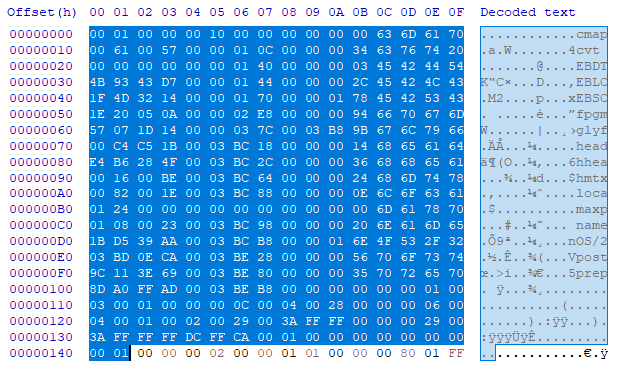
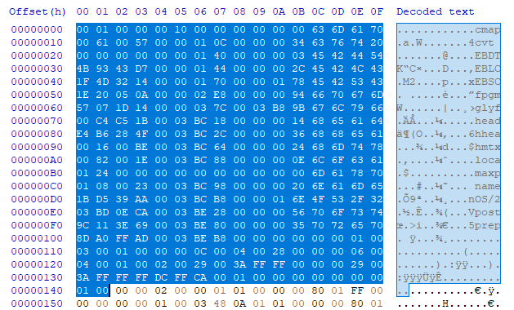
Bypassing AV signature based solutions | Example: DUQU malware
Malicious Font (DUQU malware mutation)
Malicious Font (DUQU malware)
Font file utilizing the CVE-2011-3402 exploit
Font file utilizing the CVE-2011-3402 exploit
One byte change
Multiple AVs detect this file as malicious
Only one AV engine detects this file as malicious
One byte offset completely changes the verdict!

Slide 10
DEEP LEARNING
Notes:
- Good news: that’s exactly the point of deep learning

Slide 11
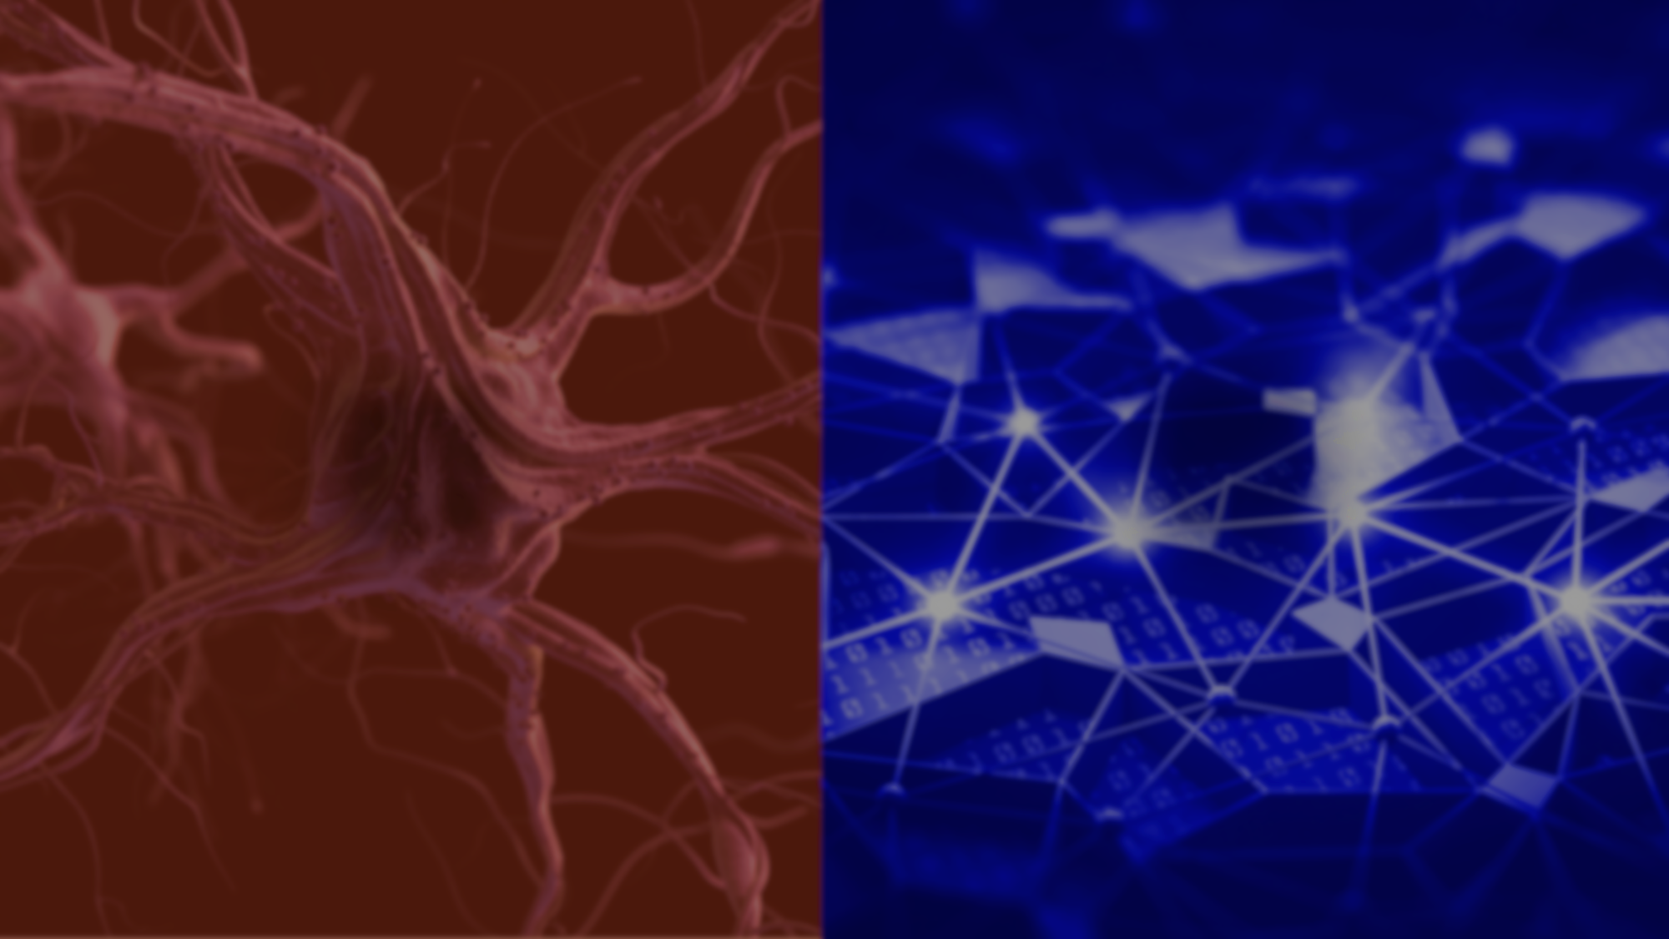

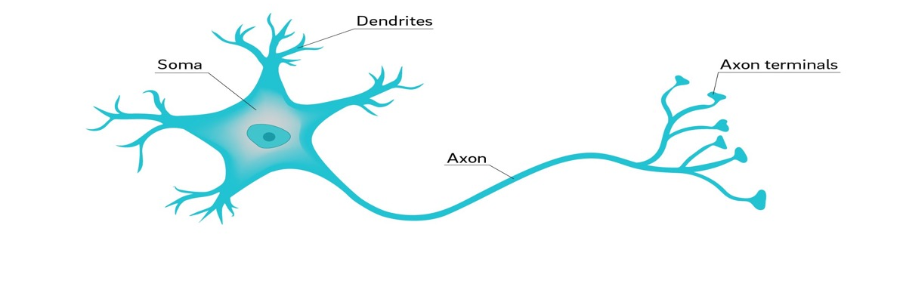
Human brain
Artificial brain
VS.
Billions of neurons connected to each other through synapses
Neuron - electrically excitable cell that receives, processes, and transmits information through electrical and chemical signals
The width of the synapse represent the connection strength between the neurons
Hundreds of thousands of “neurons” connected to each other
The connection strength between “neurons” is represent by weights

Slide 12













Real World Applications of Deep Learning
Speech recognition
NLP
Image recognition
Bio-Informatics
Recommendation system
Cyber-security
20%-30%
20%-30%
10%-20%
improvement in
face recognition
improvement in
voice recognition
improvement in
text analysis

Slide 13
EFFECT OF MORE NEURONS LAYERS
Malicious
Benign
3 hidden neuron layers
6 hidden neurons layers
20 hidden neurons layers
The more layers, the better the accuracy
Notes:
Deep learning, also known as deep neural network, is based on layers of neurons. Just like our human brain.
Each neuron represent a mathematical formula and the connections between neurons are the weights.
trying to find a classifier or a way to distinguish between bad a good samples.
In this example you can see 2 dimensions, 2 axis that represent a data feature. Now think about millions of dimensions…
The more layers the better the accuracy. But it comes with a price – performance. More layers, the worst the performance will be
There is not formula to calculate the optimum number of layers.
This where the expertise and experience of the deep learning scientists become so important.
But since this a relatively new discipline there are just not of them. And most iof them got to work for the tech giants to earn a lot of money. If I knew, I may have gone to study something else…

Slide 14
HOW CAN DEEP LEARNING BE APPLIED TO CYBERSECURITY?

Slide 15
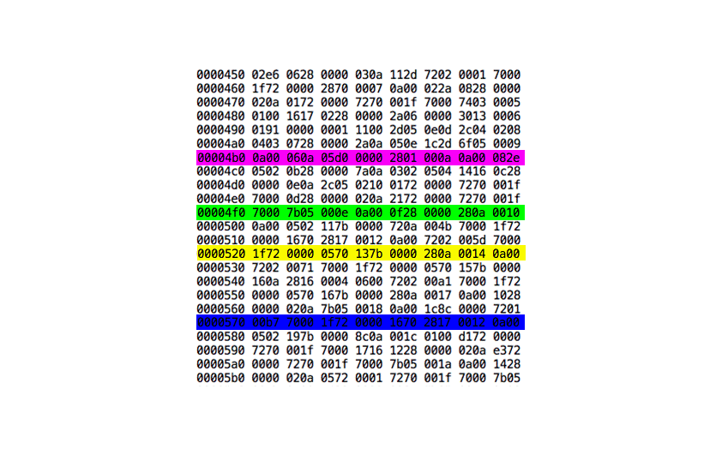
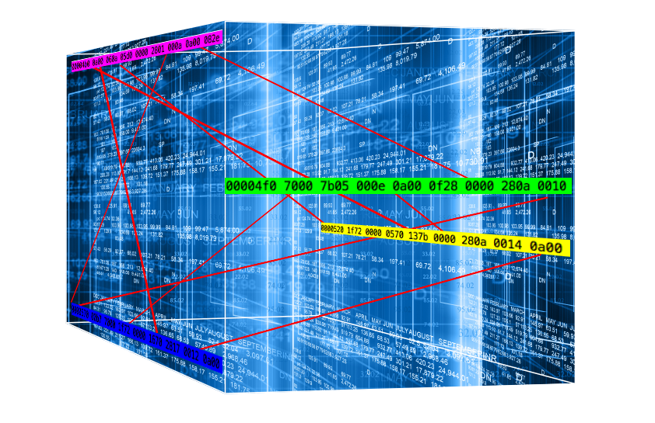
Human vs Deep Learning perspective
How human see a file
2 dimension; Linear correlation
How Deep Neural network see a file
N-dimensions ; non-linear correlation
Notes:
- Hidden

Slide 16
A BIT ABOUT US...

Slide 17
DEEP INSTINCT’S MULTI LAYERED ENDPOINT PROTECTION
PRE-EXECUTION
Prevention
ON-EXECUTION
Detection & Response
POST-EXECUTION
Deep Static Analysis
Any file type: PE | PDF | Office | Macro | RTF | SWF | JAR | TIFF | Fonts | Mach-O
D-Cloud File Reputation
Script Control
Deep Behavioral Analysis
Enhanced Ransomware | Code Injection | Known Shellcodes
File infectors (Viruses) | Worms | Keyloggers | Credentials Dumping | Banking Trojans | Spyware
Dynamic Analysis based on Deep Learning
Automatic Analysis
Deep Malware Classification | Attack timeline (Process chain) | Offline sandboxing
Remediation
Whitelist/Blacklist (Hash, Certificate, Folder, Scripts, Processes) | Import list of IoC | File quarantine & restore | Delete file remotely | Terminate process | Isolate network
* Roadmap

Slide 18



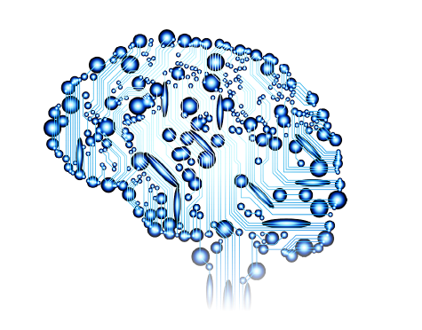




The Deep Learning Process From Training to Prediction
Deep Instinct
neural network
Third party public sources
Darknet
Home Made Malware
Mutated Malware
*.exe
*.ppt
D-Brain
*.xls
Lightweight agent: <150MB, <1% CPU
Run on any CPU
Platform-agnostic
Only two updates a year
*.pdf
*.SWF
*macro
*.dll
*.macho
*.doc
*.rtf
*.APK
Agent
Labeled examples
Supervised training
Nvidia GPUs

Slide 19
THE VALUE OF THE DEEP INSTINCT PREDICTION MODEL
Crysis Ransomware
Created 14 Months earlier
D-Client v2.0
Release day
Deep Instinct client
Detected and Prevented Crysis on a production environment
Crysis is first reported as a new ransomware family
First upload to VirusTotal
Missed by Cylance, CrowdStrike, SentinelOne, TrendMicro
2 months
August 2017
August 2018
October 2nd 2018
October 3rd 2018

Slide 20
Thank you Questions?

